Slide 1

Website Development: Lesson 6
Facilitated by: Titus Kariuki
Notes:
Web development kahoot

Slide 2
Agenda
1. Ice breaker
2. Hyperlinks
-Q&A
3. Lesson 3 Challenge 1 - Links You Love
4. Jumping
5. Lesson 3 Challenge 2 - Jump around

Slide 3

Ice Breaker
What skills have you learned in this class that you will take with you to high school/college?

Slide 4
What are Hyperlinks?
Good news! We’ve already used links
Today’s lesson focuses on the general way to embed links to other types of documents or websites

Slide 5

Embedding Links
Links in HTML are called hyperlinks - are used to jump to another “document” or website
Hyperlinks are different than most links (like pictures and google maps) because we will not display the entire document
We are adding the location of another file that users may redirect to if they want

Slide 6



Embedding Links
Functionality of Links
Links are meant to be hovered over and when clicked, redirect you to the new website or link.
Unvisited Link
Hasn’t been touched or interacted with
Visited Link
Has been clicked on/used/interacted with in the path (computers have a good memory)
Active Link
Hasn’t been touched or interacted with

Slide 7
Embedding Links
Hyperlink example
This is a Hyperlink

Slide 8


Embedding Links
There are two different kinds of URL links: Relative and Absolute
Relative:
“Local link”
Takes you to different webpage on the same website
E.g., from one part of Google to another part of Google.
Absolute:
Link to a completely different website
E.g., from Google to Apple.
Notes:
Spot the difference: absolute urls have https://www and relative urls do not

Slide 9
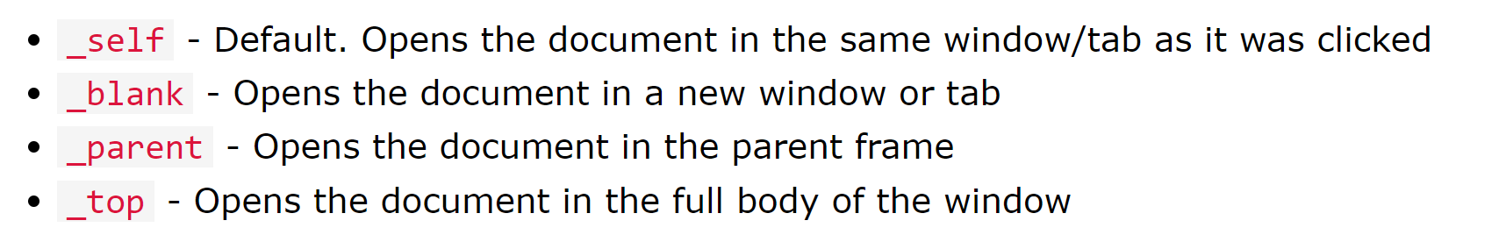
Embedding Links
Syntax
<a> defines hyperlink
“Href” attribute of <a> tag that determines destination
“Target” attribute specifies where to open the link
Same window/tab
New window/tab
Parent frame/same area as where the link is
Top: full space of the window
Include the link text after target
Notes:
Spot the difference: absolute urls have https://www and relative urls do not

Slide 10

Questions?

Slide 11
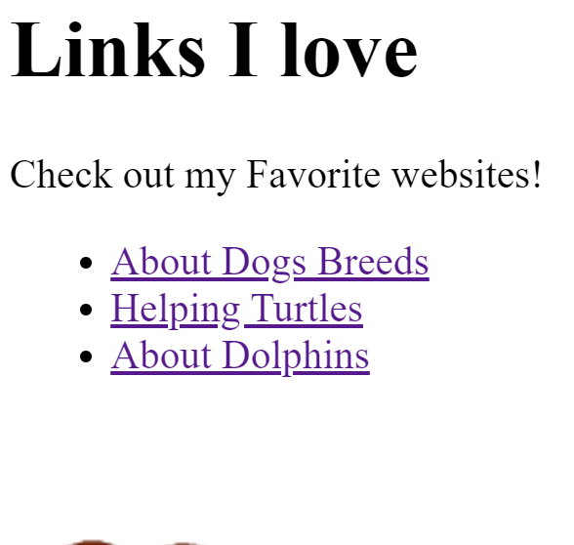
Lesson 3 Challenge 1 - Links You Love
Time to add your own hyperlinks (all links will be absolute URLs)
You may continue using your webpage from last class to enhance it more or you can start a new page

Slide 12
Lesson 3 Challenge 1 - Links You Love
Checklist:
<a> tag followed by herf and target attributes
href=”https://www.YourLink.com/”
target= “_destination (look on slide 8 for options)”
Link name/what you want it to appear as
<a/> closing tag

Slide 13
What is “Jumping”?
“Jumping” is similar to relative links
Instead of linking to a different webpage in a website, you will be linking different sections

Slide 14
Jumping
Creating the identifier
The identifier is what you’re linking.
Can be a paragraph heading or a section on the webpage.
Creating the hyperlink
The hyperlink takes you to the identifier
Jumping should make it easier for you to navigate the webpage
Notes:
Spot the difference: absolute urls have https://www and relative urls do not

Slide 15
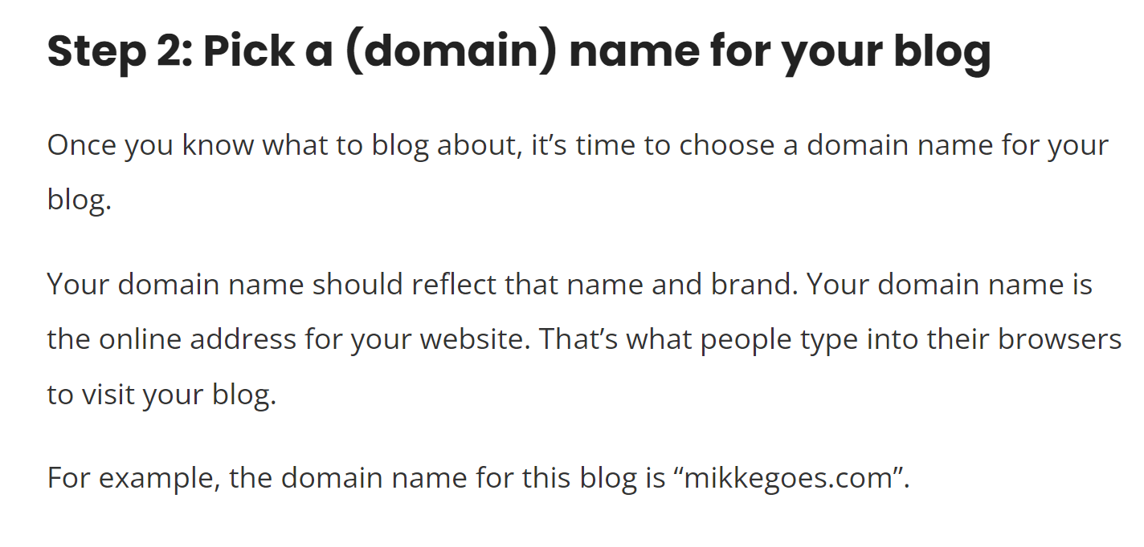
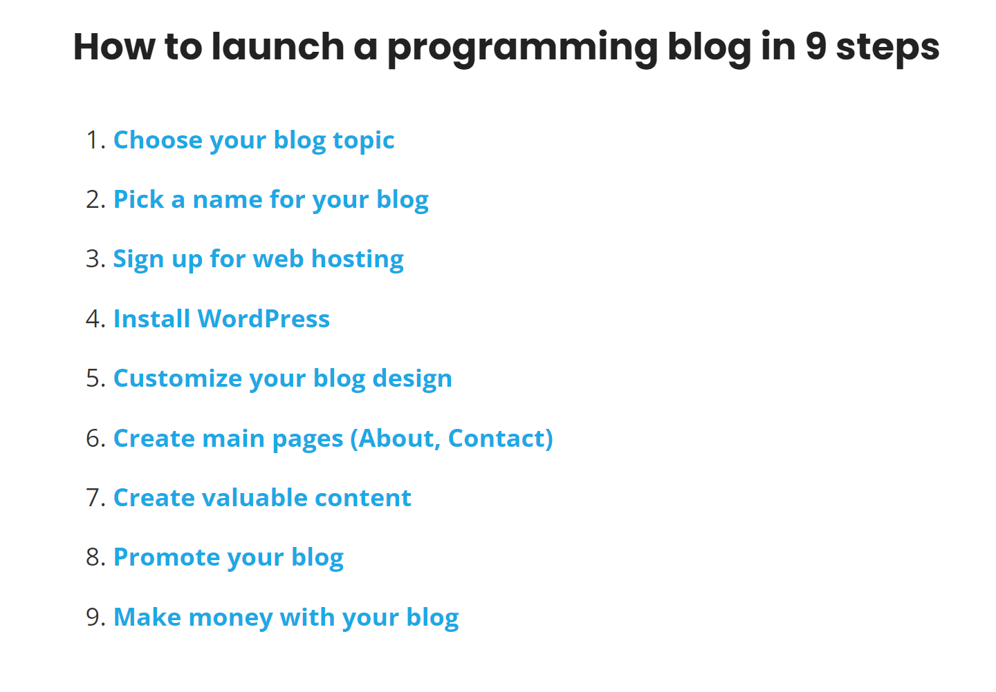
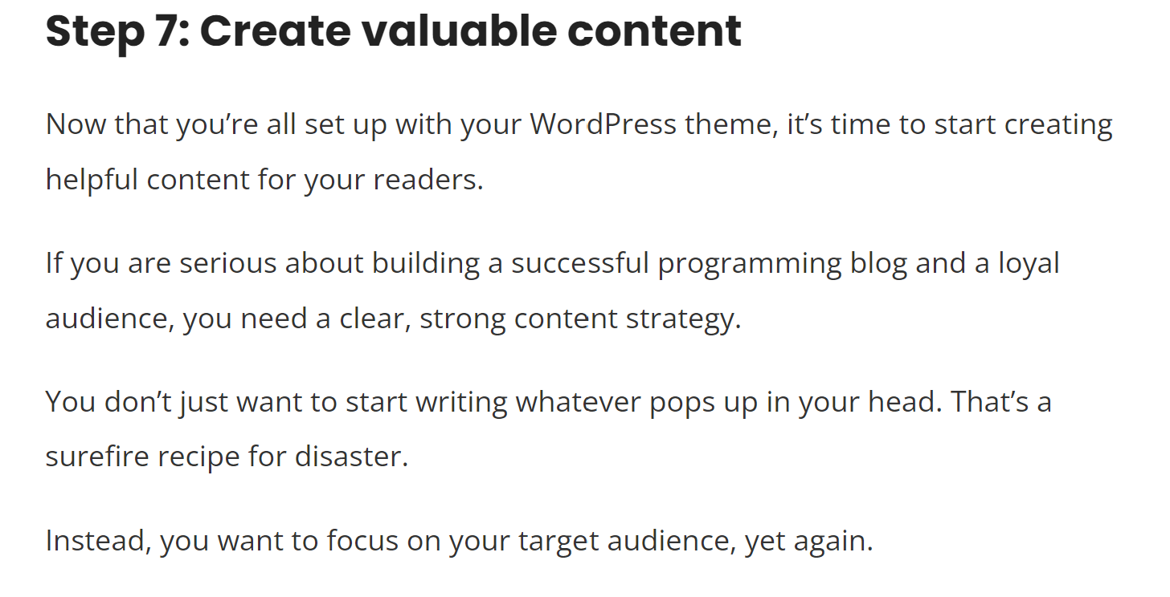
Jumping
Jumping example - Mikke Goes Coding
Notes:
Spot the difference: absolute urls have https://www and relative urls do not

Slide 16
Jumping
How to “Jump”
Identifier
Start the tag with wither a header (h1) or opening <a tag
Name the identity” id=”NAME”
Close the tag with the corresponding opening tag
Hyperlink
Open with <a tag
href=”#NAME OF ID>
This element creates the link to the id you created above so make sure it has the same exact spelling as the id
Create the name that the link will appear as
Closing </a> tag
Notes:
Spot the difference: absolute urls have https://www and relative urls do not

Slide 17
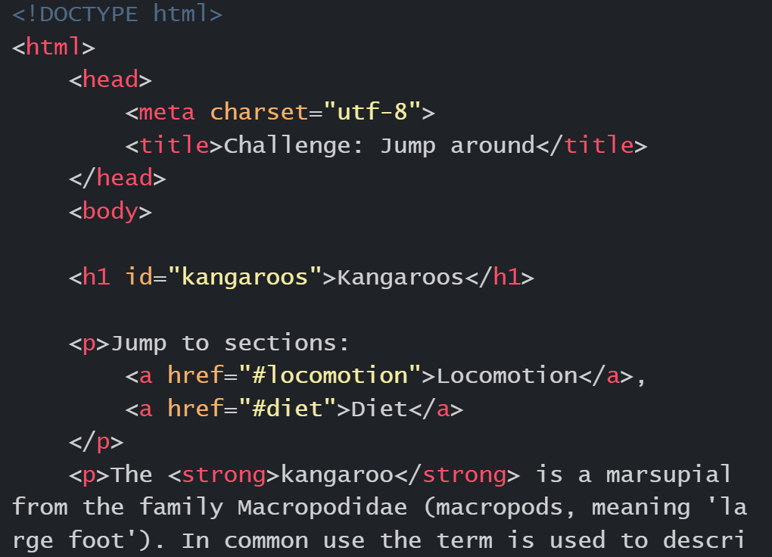
Lesson 3 Challenge 2 - Jump Around
Either continuing on your previous webpage or on a new document, create hyperlinks to different sections of you page
Checklist:
Header with id
Name of id and how it will appear on screen
Hyperlink
Opening and closing <a> tag
#LinkName
Name that will appear on screen

